Slide 1

FOOTHEALTH WEBSITE FOR A MEDICAL PRODUCT BASED COMPANY
Group No: 17
Abhishek L. Pote:17104073
Abhishek A.P. Rai:17104027
Tanmay S. Rajadhyaksha:17104025
Project Guide: Dr. Sameer Nanivadekar

Slide 2
Contents
Introduction
Objectives
Problem Definition
Technological Stack
Review Suggestions
Proposed System Architecture/Working
Prototype Design Demonstration
Plan of Paper Publication
Conclusion
Reference

Slide 3
INTRODUCTION
The development of Foothealth website is considered regarding the increasing foot pain conditions ,symptoms and treatments regarding foot. Normal patients as well as athletes suffer a lot of foot injuries which gets worsen with time because of improper attention or treatment and ignoring behaviour towards the condition. For such conditions which are severe and should be brought into light for treatment is one of the purpose the company to develop the website which will post information related to foot conditions, symptoms, treatment and prevention which will be medically reviews by physiotherapists and then will be uploaded to this website to make people aware of possible injuries to be coming and how to avoid them. The website will include many different features such as demonstration through 3D modelling for better understandability by user regarding their conditions. This website also contains the advertisement of new technology developed by company to tackle foot problems effectively and make patients realise that this product can help save them injuries in near future.

Slide 4
OBJECTIVE
To develop a blog and product advertisement website for foot health/physiotherapy product based company.
To develop fully fledged, functional and dynamic website for organization.
To integrate 3D models for demonstration of foot conditions.
To develop remote assessment using 3D model and forms.
To provide with an easy to post content and product advertisement website.

Slide 5
PROBLEM DEFINITION
Normal patients as well as athletes suffer a lot of foot injuries which gets worsen with time because of improper attention or treatment and ignoring behaviour towards the condition. Even the shoes you wear if are not comfortable to you can cause foot injuries or fractures which can sustain lifetime.
For such conditions which are severe and should be brought into light for treatment is one of the purpose the company to develop the website which will post information related to foot conditions, symptoms, treatment and prevention which will be medically reviews by physiotherapists and then will be uploaded to this website to make people aware of possible injuries to be coming and how to avoid them.
The website will include many different features such as demonstration through 3D modelling for better understandability by user regarding their conditions.
To develop online assessment for foot information and foot pain region highlighting and passing the information over mail to subject matter experts.

Slide 6
PROPOSED TECHNOLOGY STACK
Django : is a Python-based free and open-source web framework that follows the model-template-view (MTV) architectural pattern. It is maintained by the Django Software Foundation (DSF), an American independent organization established as a 501(c)(3) non-profit. Django’s primary goal is to ease the creation of complex, database-driven websites. The framework emphasizes reusability and "pluggability" of components, less code, low coupling, rapid development, and the principle of don't repeat yourself. Python is used throughout, even for settings files and data models. Django also provides an optional administrative create, read, update and delete interface that is generated dynamically through introspection and configured via admin models.
MYSQL : MySQL is free and open-source software under the terms of the GNU General Public License, and is also available under a variety of proprietary licenses. MySQL was owned and sponsored by the Swedish company MySQL AB, which was bought by Sun Microsystems (now Oracle Corporation). In 2010, when Oracle acquired Sun, Widenius forked the open-source MySQL project to create MariaDB.
HTML : Hypertext Mark-up Language (HTML) is the standard mark-up language for documents designed to be displayed in a web browser. It can be assisted by technologies such as Cascading Style Sheets (CSS) and scripting languages such as JavaScript.

Slide 7
PROPOSED TECHNOLOGY STACK
CSS : Cascading Style Sheets (CSS) is a style sheet language used for describing the presentation of a document written in a mark-up language like HTML. CSS is a cornerstone technology of the World Wide Web, alongside HTML and JavaScript.
Java Script : often abbreviated as JS, is a programming language that conforms to the ECMAScript specification. JavaScript is high-level, often just-in-time compiled, and multi-paradigm. It has curly-bracket syntax, dynamic typing, prototype-based orientation, and functions. Alongside HTML and CSS, JavaScript is one of the core technologies of the World Wide Web. JavaScript enables interactive web pages and is an essential part of web applications. The vast majority of websites use it for client-side page behavior, and all major web browsers have a dedicated JavaScript engine to execute it.
Editor :For editing and daily posting of articles and blogs on website editor is of immense importance since it makes Content Manager’s(CM) job easy by allowing CM to write article inside and editor and then render it onto html page as it is written and designed. For this website here we are using Ckeditor5 as What You See Is What You Get (WYSIWYG) editor four website articles and blog posts. WYSIWYG editor is important aspect for CM as the one posting content to website need not be knowing html at all. These editor make it as easy and seamless experience to upload content to website without hassle.

Slide 8
PROPOSED TECHNOLOGY STACK
Three.js :
Three.js allows the creation of graphical processing unit (GPU)-accelerated 3D animations using the JavaScript language as part of a website without relying on proprietary browser plugins.This is possible due to the advent of WebGL.
High-level libraries such as Three.js or GLGE, SceneJS, PhiloGL, or a number of other libraries make it possible to author complex 3D computer animations that display in the browser without the effort required for a traditional standalone application or a plugin.

Slide 9
Review Suggestions
Feedback information to be analyzed and displayed on website.

Slide 10
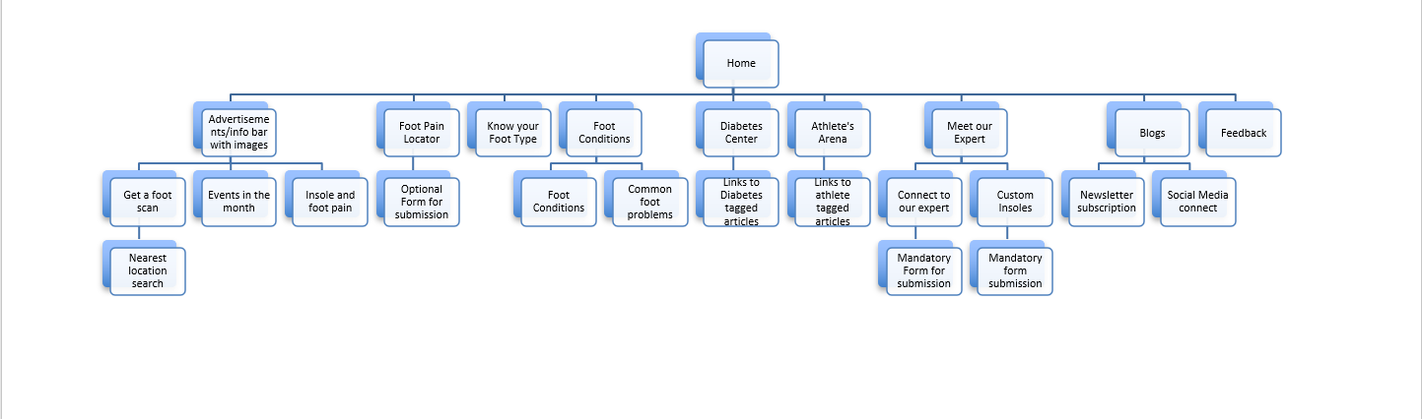
PROPOSED SYSTEM ARCHITECTURE/WORKING
Linking to pages within the site will be at several places as per individual page layouts for.e.g. Get a foot scan would appear as a banner(link) on many pages
External links to Amazon, Flipkart, social media may also appear as banners/buttons and links to them
External links to Stepp test or OHm3000 (www.ohmsmat.com) can also be provided

Slide 11
PROPOSED SYSTEM ARCHITECTURE/WORKING
Administrative panel
Access control
Content manager (CM)
Site administrator (SA)
Access to customer forms, feed back databases (Gen)
Content addition (CM)
Advertising panel(top of home page)
Organization of ads (3/5).
Store all old ads
First to view on opening home page

Slide 12
PROPOSED SYSTEM ARCHITECTURE/WORKING
Add new articles ( many tags need to be created so that they can be cross referenced)
In foot conditions and common foot problems
In diabetes center
In athletes corner
Add new blog articles
Organization of blog articles (which one first etc)
Edit external links – e-com, social media etc (SA)
Cross linking social media (SA)

Slide 13
PROPOSED SYSTEM ARCHITECTURE/WORKING
Edit forms, articles and blogs, newsletters (SA)
Edit Images in articles (change) (CM)
Add new branch on home page (SA)
Add new branch on sub pages (SA)
Newsletter service management (Gen)
Security and Privacy policies (SA)

Slide 14
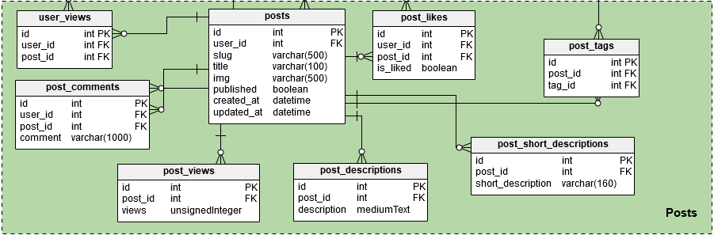
PROPOSED SYSTEM ARCHITECTURE/WORKING
This fig is a reference database for blogs or articles to be posted on website which includes different constrains for storing post information as well as its retrieval and view to be reflected on site. The whole website database will also be designed subsequently as the website development progresses further.

Slide 15
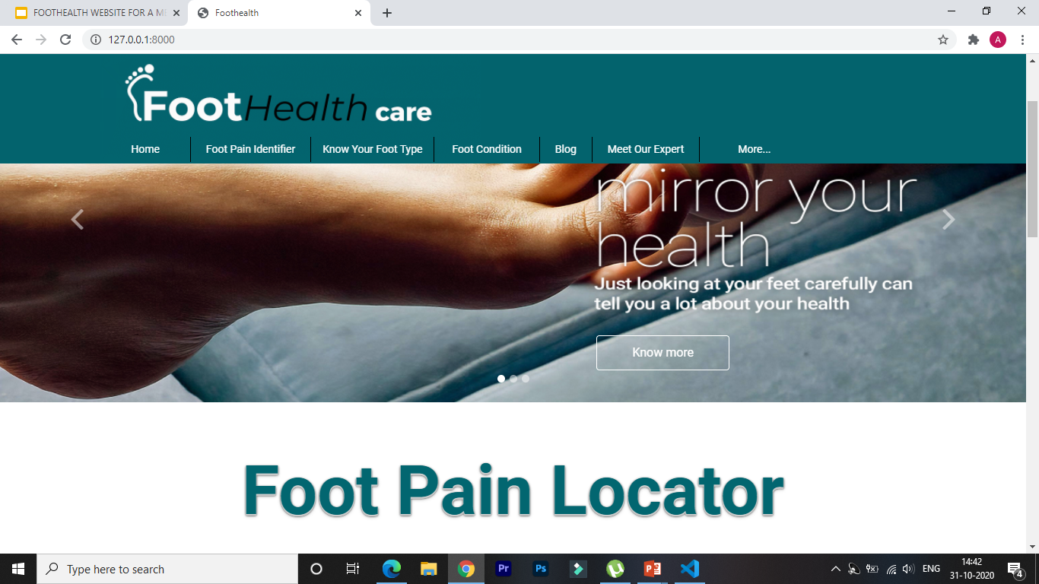
Prototype Design Demonstration
hjkkh
Home Page

Slide 16
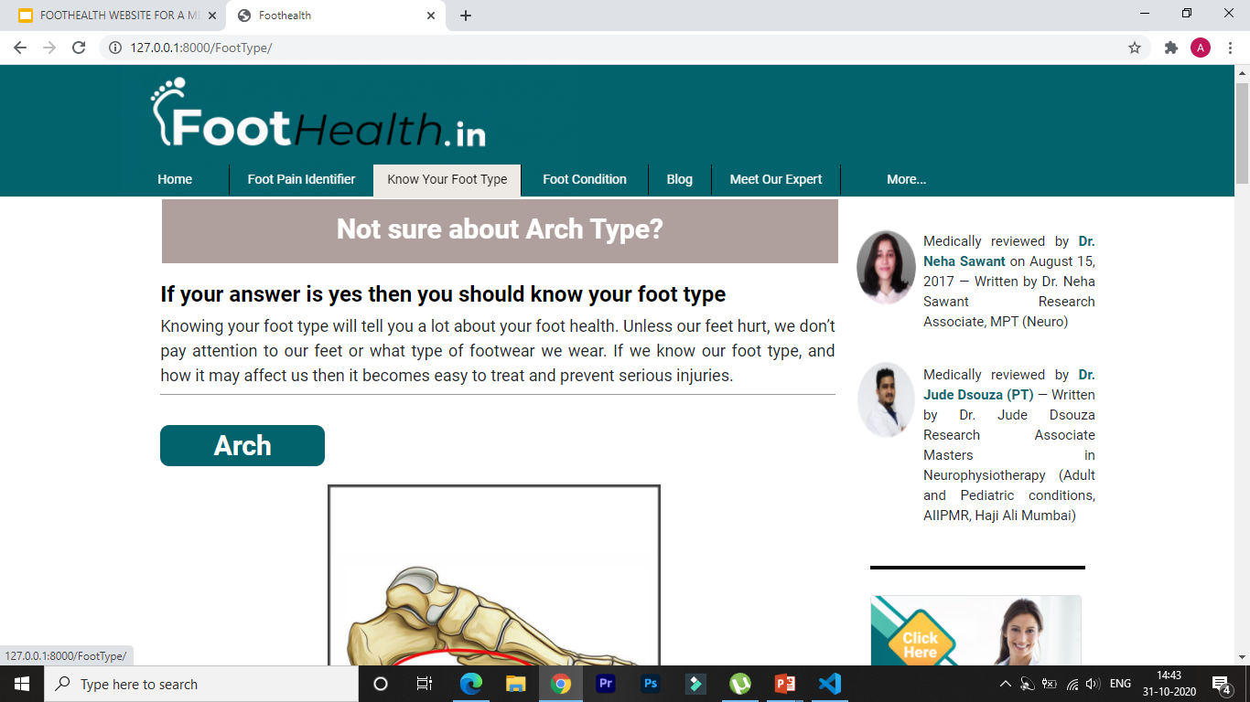
Prototype Design Demonstration
Know Your Foot Type page

Slide 17
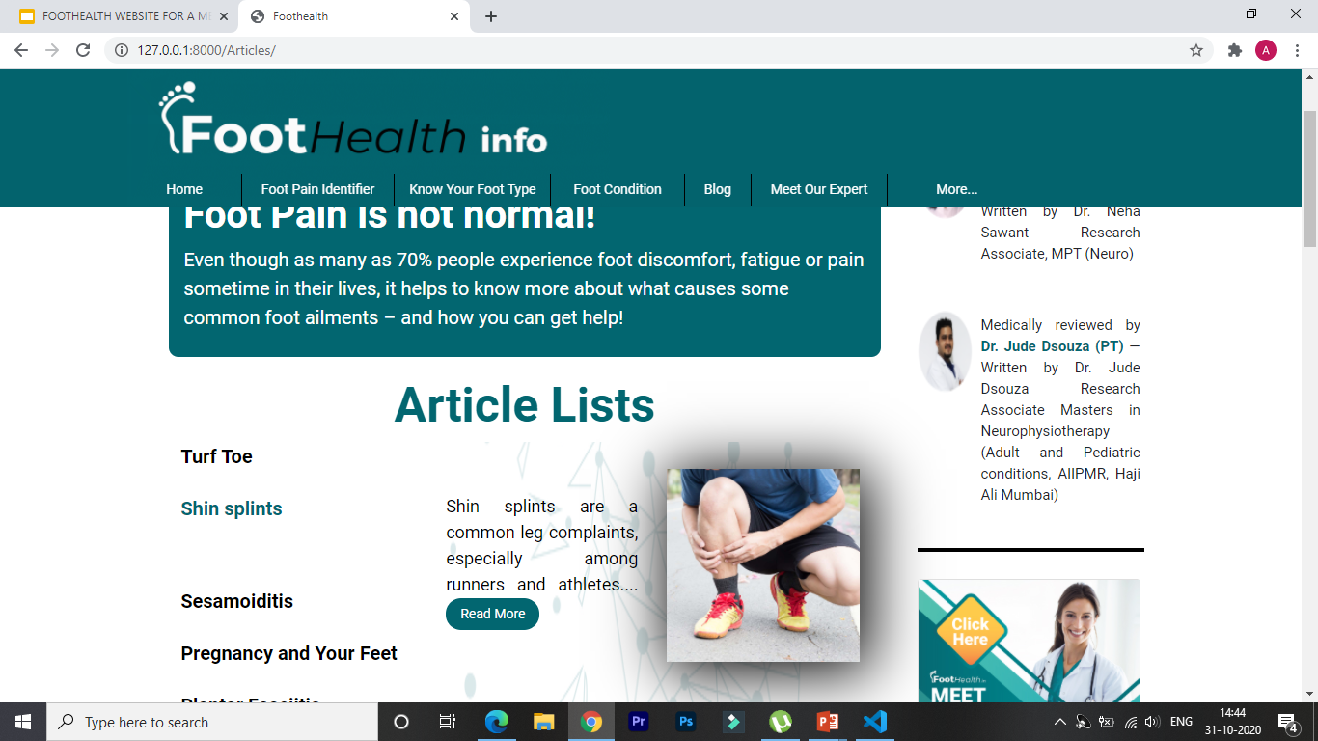
Prototype Design Demonstration
Foot Conditions page containing different articles topic in list in which we can see the brief of what information article contains.

Slide 18
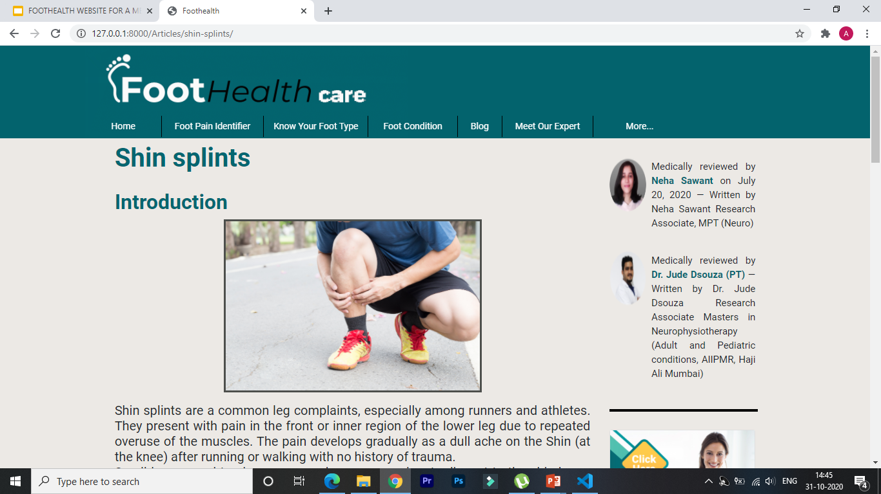
Prototype Design Demonstration
Detailed Article page of one of the topic present in Foot Conditions page

Slide 19
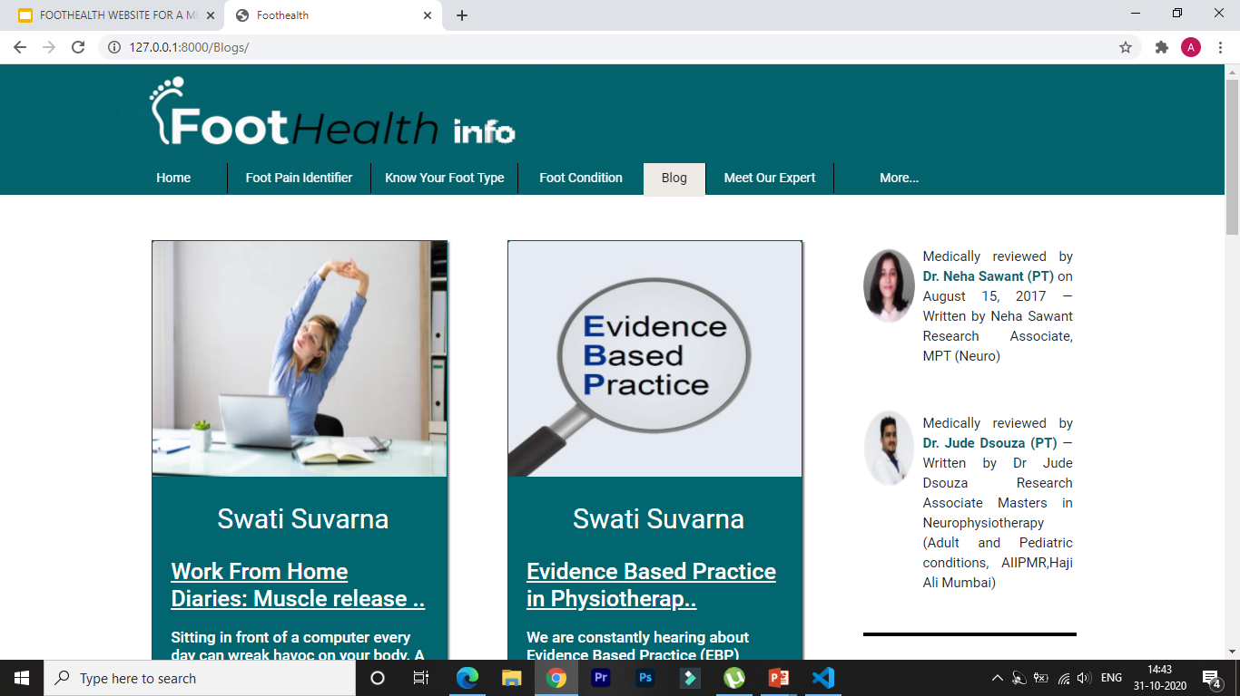
Prototype Design Demonstration
Blog page containing list blog different topics related to health issue

Slide 20
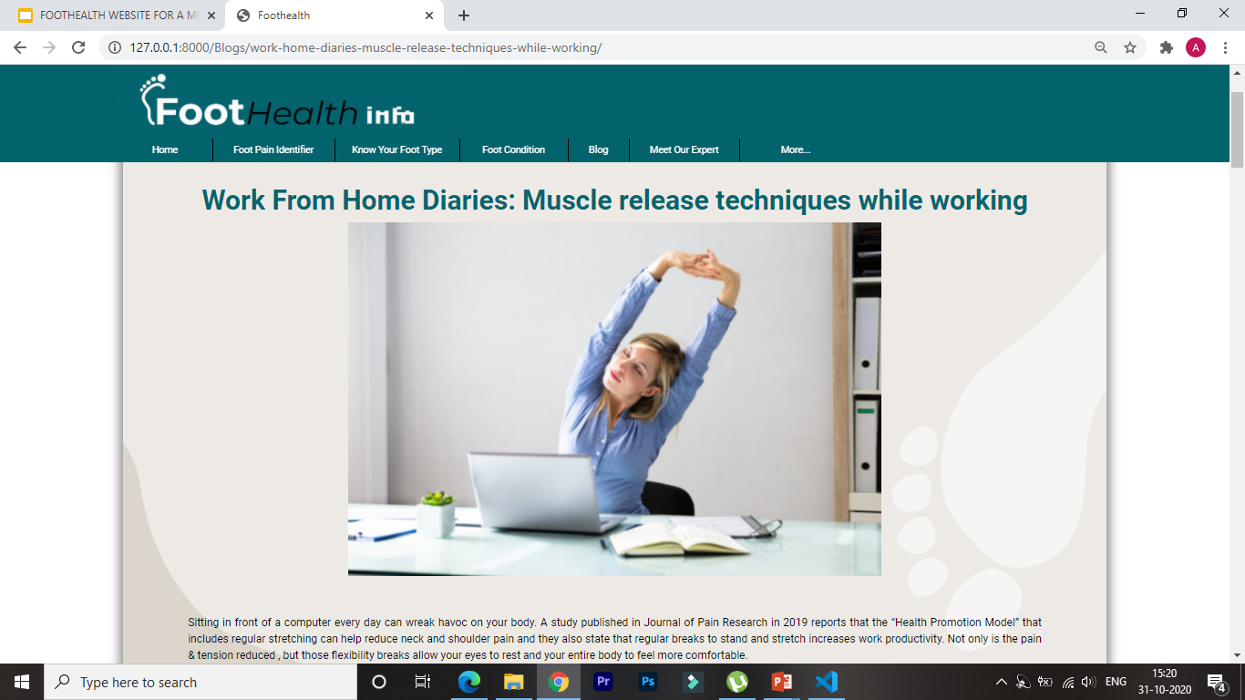
Prototype Design Demonstration
Detailed Blog page of one of the topic present in Blog page

Slide 21
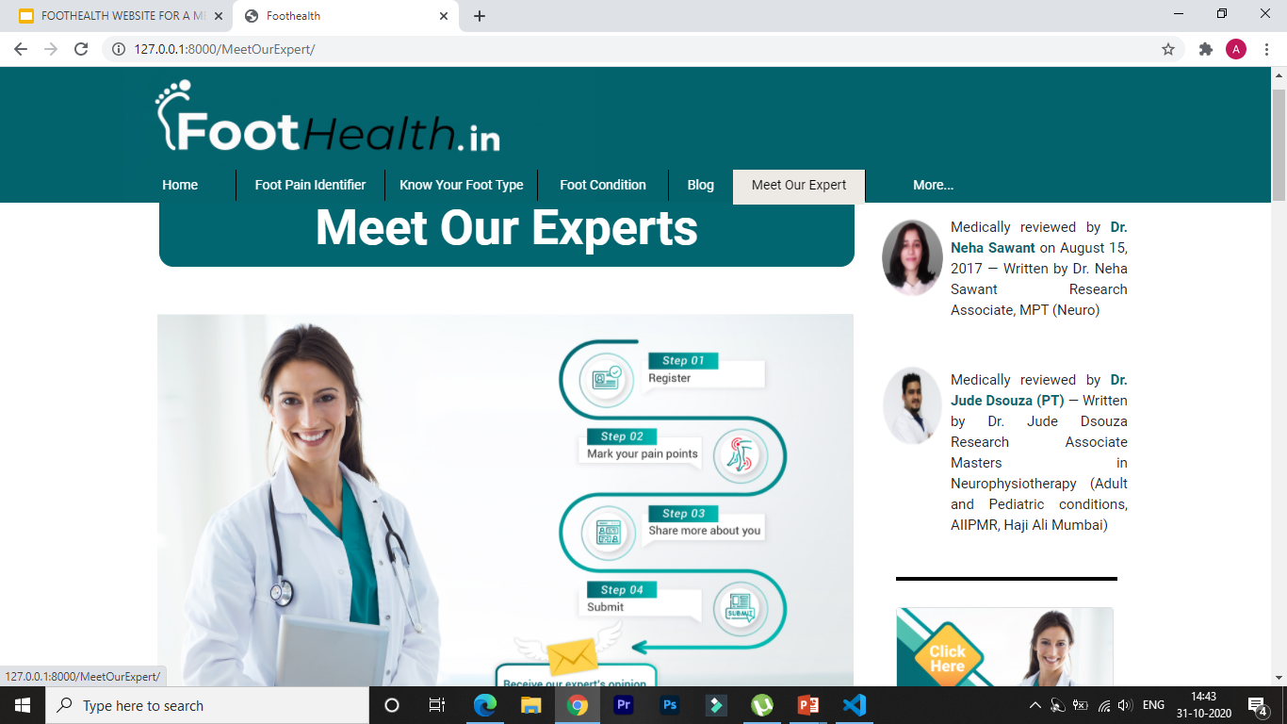
Prototype Design Demonstration
Meet our Experts Page

Slide 22
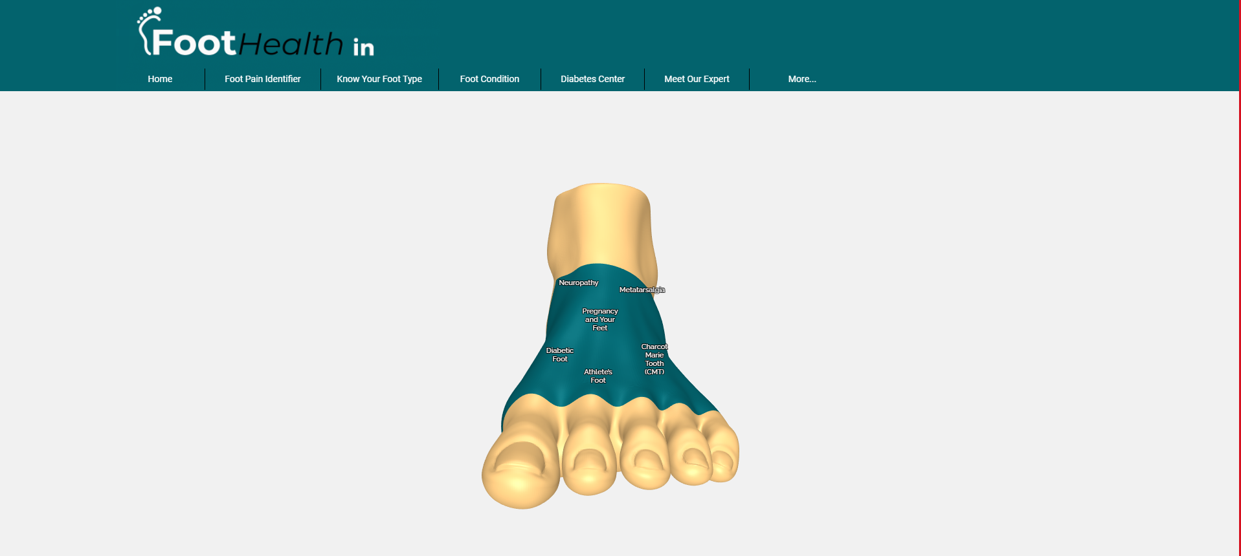
Prototype Design Demonstration
Foot Pain Locator

Slide 23
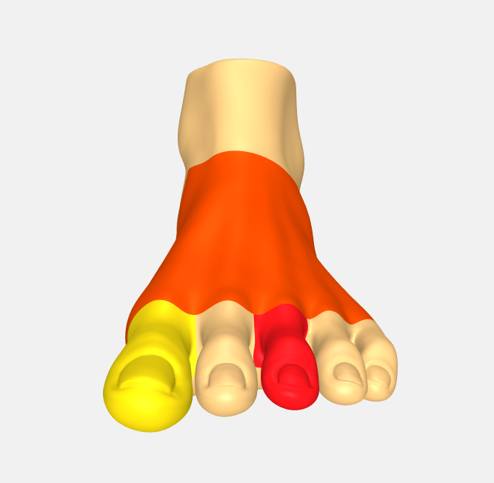
Prototype Design Demonstration
Foot Pain regions for form

Slide 24
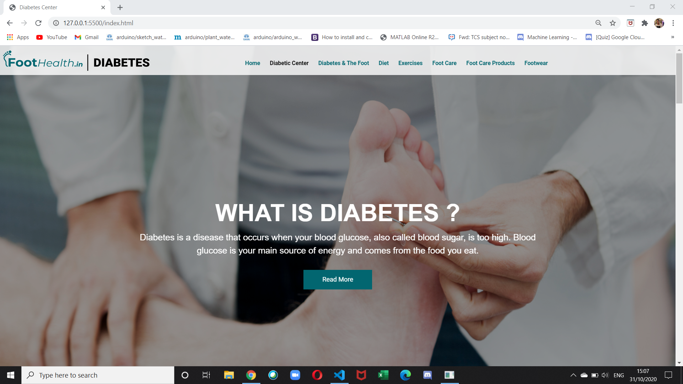
Prototype Design Demonstration

Slide 25
CONCLUSION
With the above proposed technology stack and proposed architecture we can implement this website on the public domain of the company where different users or clients of the company can visit the website for the queries related to their foot health and the company can post the blogs and different articles related to the foot health as a site administrator.Users can get to know about the products of the company through the site.Users can also use self assessment form to get guidance from medical about foot problems.

Slide 26
Plan of Paper Publication

Slide 27
REFERENCES
https://www.healthline.com/health/meniscus-tears
https://www.drscholls.com/symptoms-and-conditions/foot/
https://developer.biodigital.com/
https://ckeditor.com/ckeditor-4/
https://threejs.org/

